Slide 1
HYPOTHESIS TESTING:
Is the Average Body Temperature 98.6°F?
Mary Le, Elle Nguyen, Andy Wang

Slide 2
OVERVIEW
The "normal" human body temperature is often cited as 98.6°F
This value was established by Carl Wunderlich in the 19th century
More recent studies suggest average body temperature may be lower (98.2 °F)
Goal: use hypothesis testing to evaluate if the true mean body temperature is 98.6°F based on a sample of 130 individuals
Notes:
The reason we choose this topic is because more recent studies suggest average body temperature may be lower (98.2 °F).
And to test if this hypothesis is true or not, we use hypothesis testing to evaluate if the true mean body temperature is 98.6°F based on a sample of 130 individuals.

Slide 3
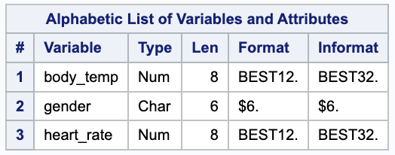
DATASET
Source: https://www.openintro.org/data/index.php?data=thermometry
Format: A data frame with 130 observations on the following 3 variables
body_temp: body temperature in degrees Fahrenheit
gender: gender of participant, with levels female male
heart_rate: heart rate, in beats per minute
Notes:
Source: our dataset comes from the website openinto
Download the data in csv file and then import into SAS for further analysis
Format: The dataset contains three variables, bodyTemp, gender and heartRate. Variable type -> Numerical

Slide 4
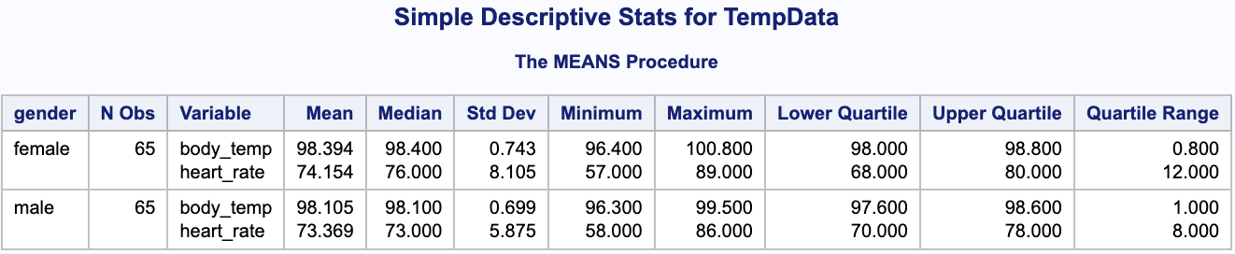
DESCRIPTIVE STATISTIC
Summary Statistics by Gender
Notes:
Mention mean, median and std
Sorted by gender

Slide 5
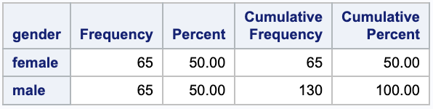
DESCRIPTIVE STATISTIC
Frequency Distribution by each Gender class
Even distribution:
50% female
50% male
Notes:
Use proc freq, frequency even、percent even whole dis even

Slide 6
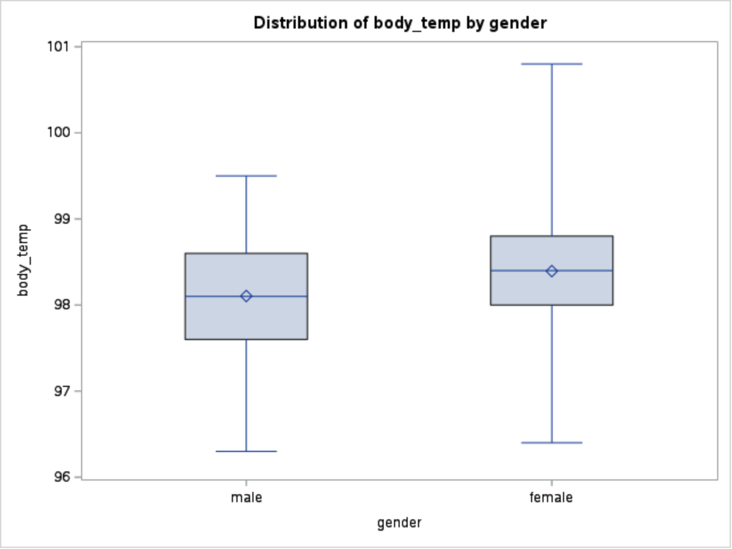
VISUALIZATION
Similar median body temperatures
Slightly higher variability in female temperatures
No outliers
Notes:
Box plot -> show dist of bodyTemp by gender
Mean body temp: 98.105°F (male), 98.394°F (female)
Standard deviation: 0.699°F (male), 0.743°F (female)
Range: 96.3°F to 99.5°F (male), 96.4°F to 100.8°F (female)
By this obs

Slide 7
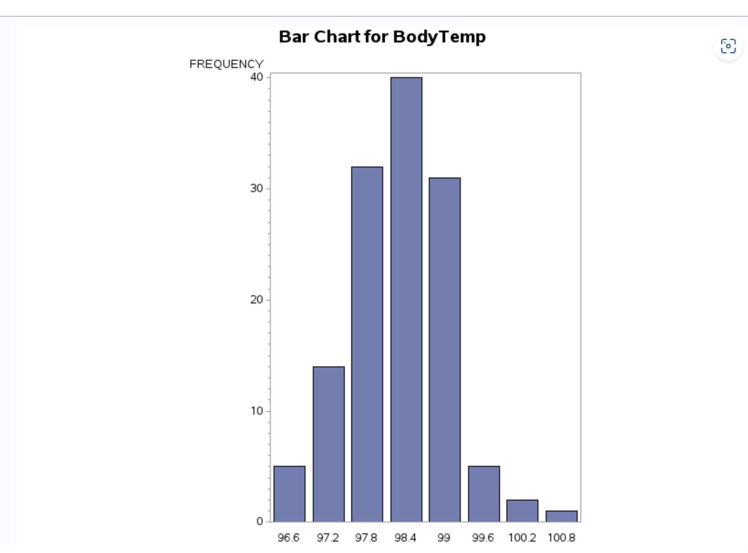
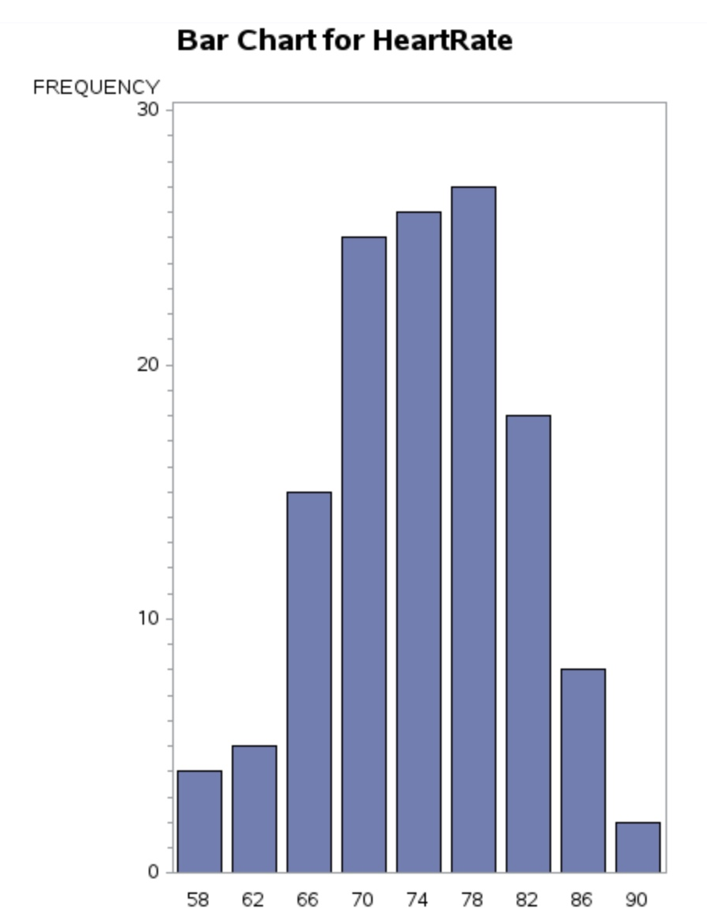
VISUALIZATION
- Most frequent temperature range: 98°F to 99°F
- Observations beyond the accepted normal range
- Common heart rates cluster around 70 to 80 beats per minute
- Lower frequencies observed in the higher heart rate intervals
Notes:
Moving on to our next visual, let's take a look at the frequency distribution of body temperatures within our dataset. This bar chart, reveals the most common body temperature range among our participants, which predominantly falls between 98°F and 99°F. It's interesting to note this, as it's slightly below the traditional standard of 98.6°F that we've long considered to be the average.
you'll see that there are observations that lie beyond what is typically accepted as the 'normal' body temperature range. These deviations could be indicative of measurement variability, individual health status, or even environmental factors at play during data collection. Such insights challenge the notion of a one-size-fits-all average body temperature.
Let's shift our focus to another vital sign: heart rate. This chart illustrates the variability in heart rates across our sample. As we can see, the bulk of heart rate readings clusters around 70 to 80 beats per minute. This range is generally considered normal for resting heart rates in adults
However, we also notice that the frequency diminishes significantly as we move into higher heart rate intervals. Such a distribution is expected, but it prompts further investigation. Are the higher rates associated with physical activity, emotional states, or health conditions? It's this kind of question that can lead to more nuanced understanding and potentially, personalized health guidance.

Slide 8
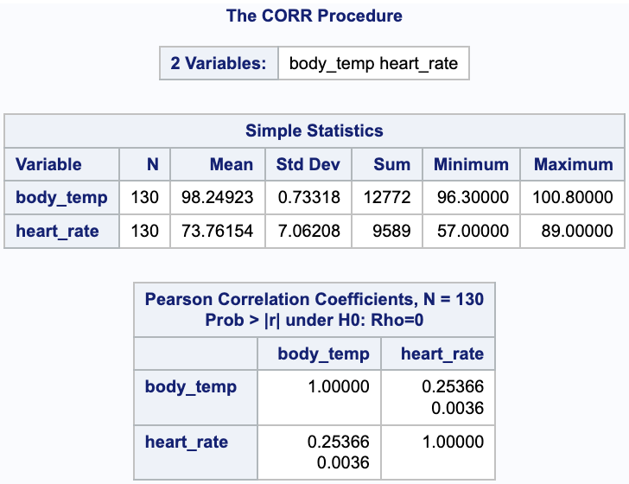
Correlation Analysis
Pearson correlation coefficient of 0.25366 suggests a positive relationship
The p-value of 0.0036 indicates statistical significance
→ As heart rate increases, body temperature tends to increase, albeit to a modest extent
Notes:
Use proc corr

Slide 9
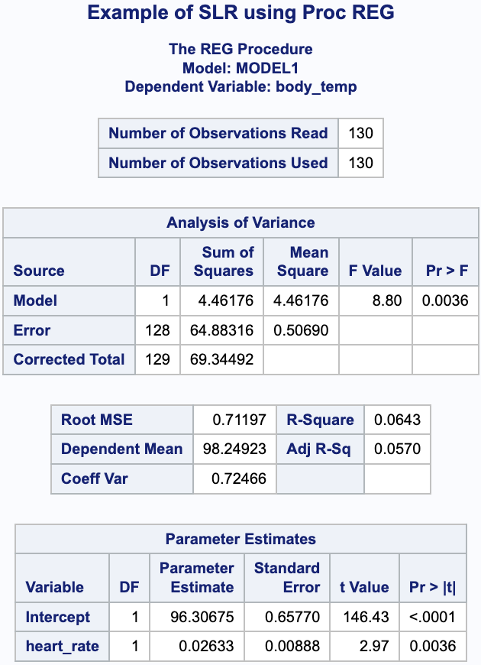
Regression Analysis
p value: 0.0036
R-square value: 0.0643 -> heart rate explains about 6.43% of the variability in body temperature
An increase in heart rate by 1 beat per minute is associated with an increase in body temperature by approx 0.02633
-> p<0.05 indicates significant relationship -> Small r-square implies heart rate has small effect on body temperature
Notes:
Proc reg
p-value = significance relationship R-square = how much it impacts other variables

Slide 10
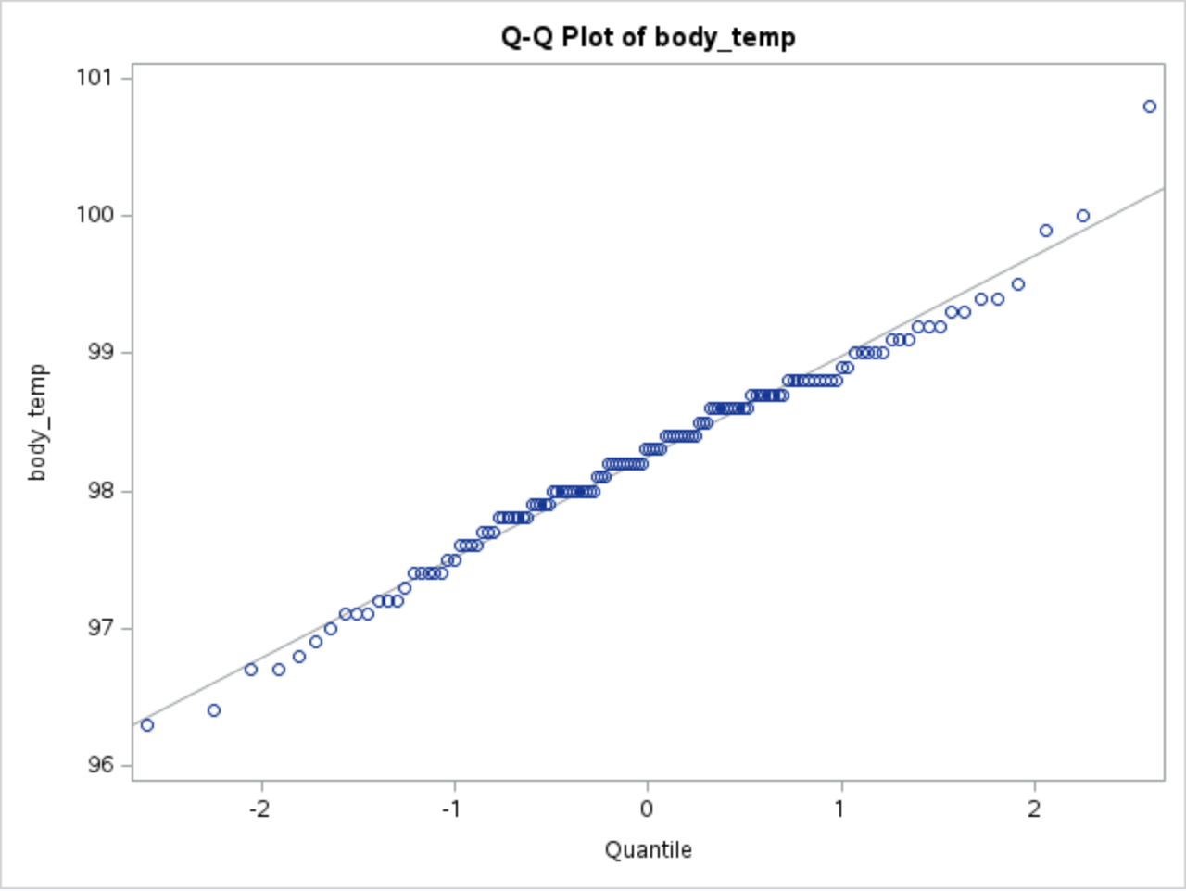
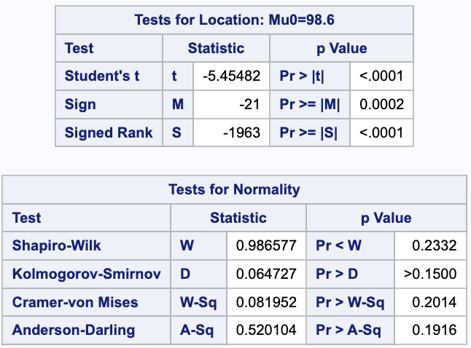
Normality Checks
- The points follow closely to the line
-> Sample data is from a normally distributed population
- Shapiro-Wilk normality test supports normal distribution (p > 0.05)
Notes:
While q-q plots indicate normality, we want to perform additional normality test (Shapiro-Wilk) to reinforce out finding

Slide 11
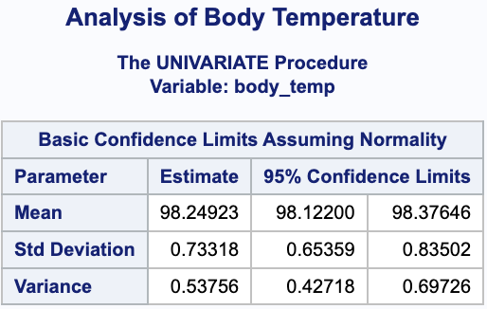
Confidence Intervals
- Confidence interval: 98.12°F to 98.38°F
-> 95% confident the true mean body temp is between 98.12°F and 98.38°F
-> Interval does not contain 98.6°F, suggesting the true mean may differ from this value

Slide 12
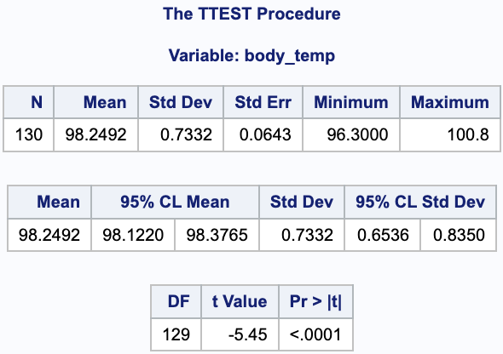
One-Sample t-Test
Null hypothesis (H0): μ = 98.6
Alternative hypothesis (Ha): μ ≠ 98.6
t-value: -5.45, p-value: <0.0001
-> Reject the null hypothesis that the average body temperature is 98.6°F
Notes:
Null hypothesis (H0): μ = 98.6 (average body temp is 98.6°F)
Alternative hypothesis (Ha): μ ≠ 98.6 (average body temp differs from 98.6°F)

Slide 13
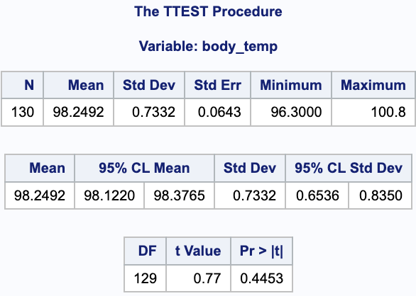
One-Sample t-Test (cont.)
Null hypothesis (H0): μ = 98.2
Alternative hypothesis (Ha): μ ≠ 98.2
t-value: 0.77, p-value: 0.44
-> Fail to reject the null hypothesis that the average body temperature is 98.2°F

Slide 14

THANKS!
Any questions?

Slide 15
REFERENCES
Dataset background: https://jse.amstat.org/v4n2/datasets.shoemaker.html
Project inspiration: https://walton.uark.edu/enterprise/exercises-usecases-labs/files/sas/sas5eg_update.pdf

